Slide 1
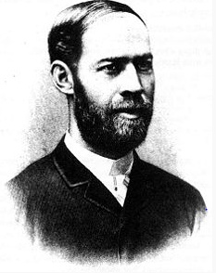

Slide 2
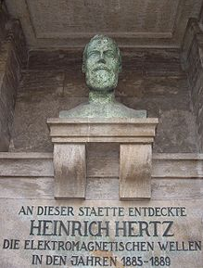
Heinrich Rudolf Hertz (February 22, 1857 – January 1, 1894) was a German physicist who clarified and expanded the electromagnetic theory of light that had been put forth by Maxwell. He was the first to satisfactorily demonstrate the existence of electromagnetic waves by building an apparatus to produce and detect VHF or UHF radio waves.

Slide 3
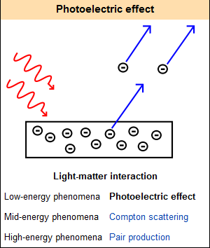
electrons are emitted from matter as a consequence of their absorption of energy from electromagnetic radiation of very short wavelength, such as visible or ultraviolet light. Electrons emitted in this manner may be referred to as "photoelectrons".

Slide 4
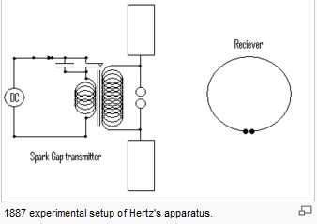
In 1887, Hertz experimented with radio waves in his laboratory. These actions followed Michelson's 1881 experiment which did not detect the existence of aether drift, Hertz altered the Maxwell's equations to take this view into account for electromagnetism.

Slide 5
He stated that,
"It's of no use whatsoever[...] this is just an experiment that proves Maestro Maxwell was right - we just have these mysterious electromagnetic waves that we cannot see with the naked eye. But they are there." Asked about the ramifications of his discoveries, Hertz replied,
"Nothing, I guess."

Slide 6
His receiver, a precursor to the dipole antenna, was a simple half-wave dipole antenna for shortwave. Hertz published his work in a book titled: Electric waves: being researches on the propagation of electric action with finite velocity through space.

Slide 7
Thank you

