Slide 1
History of periodic table

Slide 2
Aristotle ~330 BC
Four element theory: earth, air, fire & water
Antoine Lavoisier ~1770-1789
Wrote the first extensive list of elements containing 33 elements. Distinguished between metals and non-metals.

Slide 3
Jöns Jakob Berzelius 1828
Developed a table of atomic weights.
Johann Döbereiner 1829
Developed 'triads', groups of 3 elements with similar properties. Lithium(Li), sodium(Na) & potassium(K) formed a triad. Calcium(Ca), strontium(Sr) & barium(Ba) formed a triad. Chlorine(Cl), bromine(Br) & iodine(I) formed a triad.

Slide 4
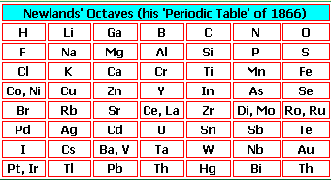
John Newlands 1864
The known elements (>60) were arranged in order of atomic weights and observed similarities between the first and ninth elements, the second and tenth elements etc. He proposed the 'Law of Octaves'.

Slide 5
Lothar Meyer 1869
Compiled a Periodic Table of 56 elements based on the periodicity of properties such as molar volume when arranged in order of atomic weight.( )

Slide 6
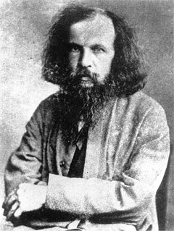
Dmitri Mendeleev 1869
Produced a table based on atomic weights but arranged ‘ periodically' with elements with similar properties under each other. Gaps were left for elements that were unknown at that time and their properties predicted (the elements were gallium, scandium and germanium). The order of elements was re-arranged if their properties dictated it, eg, tellerium is heavier than iodine but comes before it in the Periodic Table.

Slide 7
William Ramsay 1894
Discovered the Noble Gases.
Henry Moseley 1913
Determined the atomic number of each of the elements. He modified the 'Periodic Law' to read that the properties of the elements vary periodically with their atomic numbers. Moseley's modified Periodic Law puts the elements tellerium and iodine in the right order, as it does for argon and potassium, cobalt and nickel. 1914 Predicted that there were 3 unknown elements between aluminium and gold and concluded there were only 92 elements up to and including uranium

Slide 8
Glenn Seaborg 1940
Synthesised transuranic elements (the elements after uranium(U) in the periodic table)

