Slide 1
Photoelectric Effect
Clarisse, Vicky and Stephanie

Slide 2
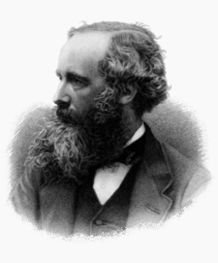
Contributions of James Maxwell
By Clarisse

Slide 3
Who is James Maxwell?
He was a Scottish theoretical physicist and mathematician

Slide 4
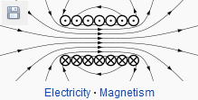
Why he is concerned with Photoelectric Effect ?
Because his most important achievement ---formulating classical electromagnetic theory

Slide 5
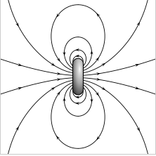
Maxwell’s theory base on Gauss's law for magnetism
This is gauss’s law for magnetism

Slide 6
Maxwell’s theory
a changing magnetic field can stimulate the vortex electric field.
a changing electric field can stimulate the vortex magnetic field.
electric and magnetic fields are not isolated from each other, they are interrelated and mutually stimulate the formation of a uniform electromagnetic field.

Slide 7
One day, when Hertz was doing spark discharge experiment to prove electromagnetic theory, he found Photoelectric Effect!

Slide 8
This is the Contributions of James Maxwell!
Because of his theory, Hertz found Photoelectric Effect, and Einstein perfect Photoelectric Effect.

